Slide 1

Chatbot With Machine Learning
Joaquin de la Guardia

Slide 2
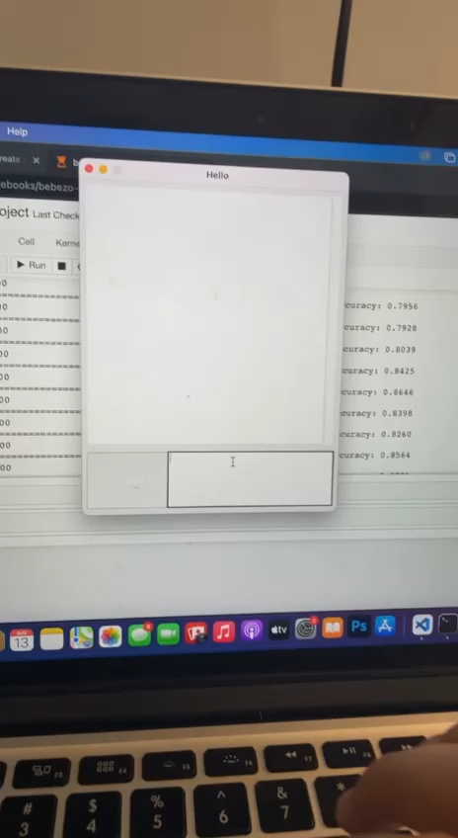
What is it?

Slide 3
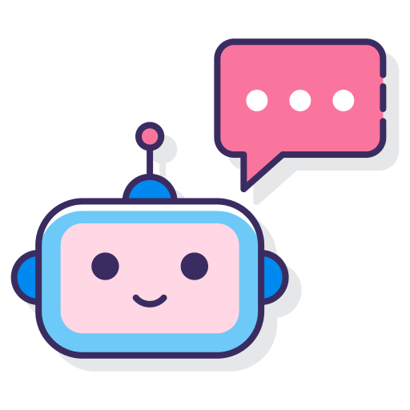
Procedure and Process
1. Establish training data & libraries to use
2. Create deep learning model
3. Train model
4. Create GUI
5. Run the chatbot

Slide 4
Training Details
Learning model Sequential from Keras
3 layers
The first has 128 neurons
The second one having 64 neurons
The third one having the number of intents as the number of neurons
Model trained with stochastic gradient descent
In our predict_class() function, we use an error threshold of 0.25 to avoid too much overfitting.

Slide 5
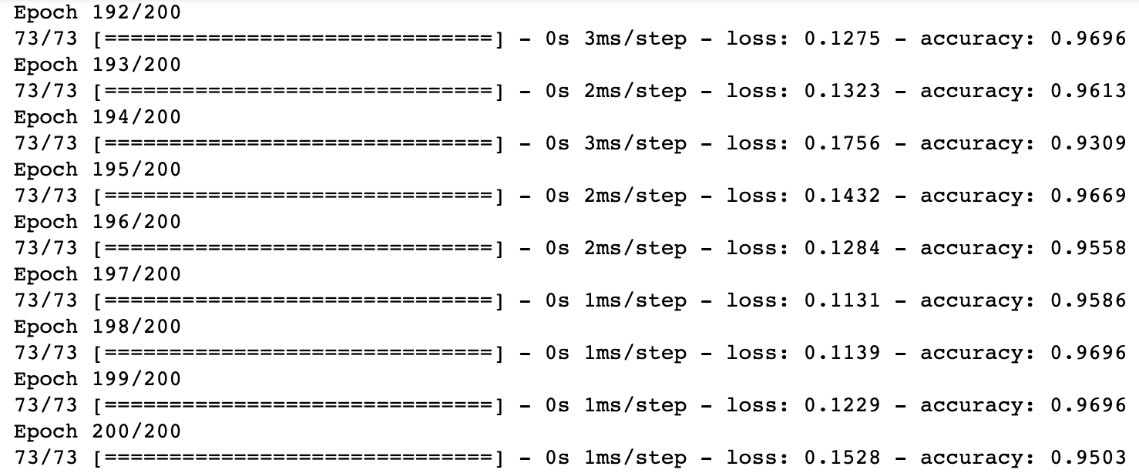
Error Bars At Epoch 192-200

Slide 6
Theoretical Results
Assumptions:
First few responses are easier to predict
Limited amount of data will cause wrong predictions
Program will be effective at handling expected intents
Proofs:
Highest accuracy of 0.98 on expected intents
Gave empty or incorrect responses with unexpected intents
Often effective

Slide 7
Social Impact Limitations
No evidence of ethical concerns or improper behavior yet
Possible Benefit → Personalized Education Chatbot
Room for improvement on simple keras neural network
Limited amount of data
Trying different frameworks

Slide 8
Existing Assets
Imported Libraries:
Nltk
Json
Pickle
Numpy
Deep Learning Framework:
Keras
Code for model obtained from internet source
Intents and responses data file came from internet source

